Slide 1
HOTEL MANAGEMENT SYSTEM
MINI PROJECT
Suryansh Taragi

Slide 2
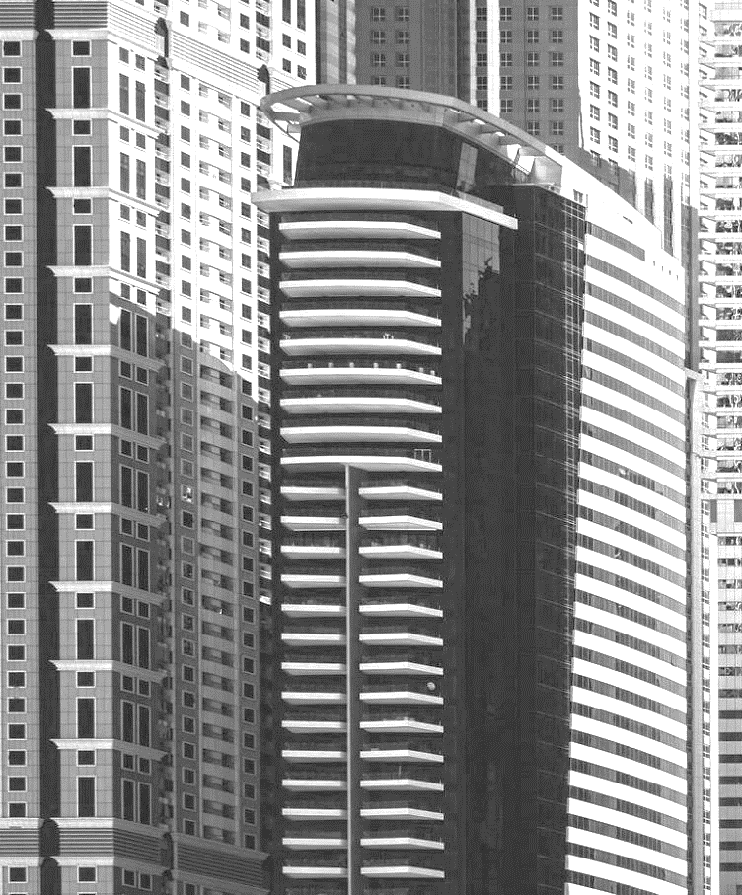

AGENDA
INTRODUCTION
Layout
Technology used
SUMMARY

Slide 3

INTRO
A hotel management system is a software application that is designed to automate and streamline the operations of a hotel. It is a comprehensive solution that helps hotel managers and staff to efficiently manage and organize their daily tasks such as reservations, check-ins, check-outs, billing, inventory management, housekeeping, and more.

Slide 4
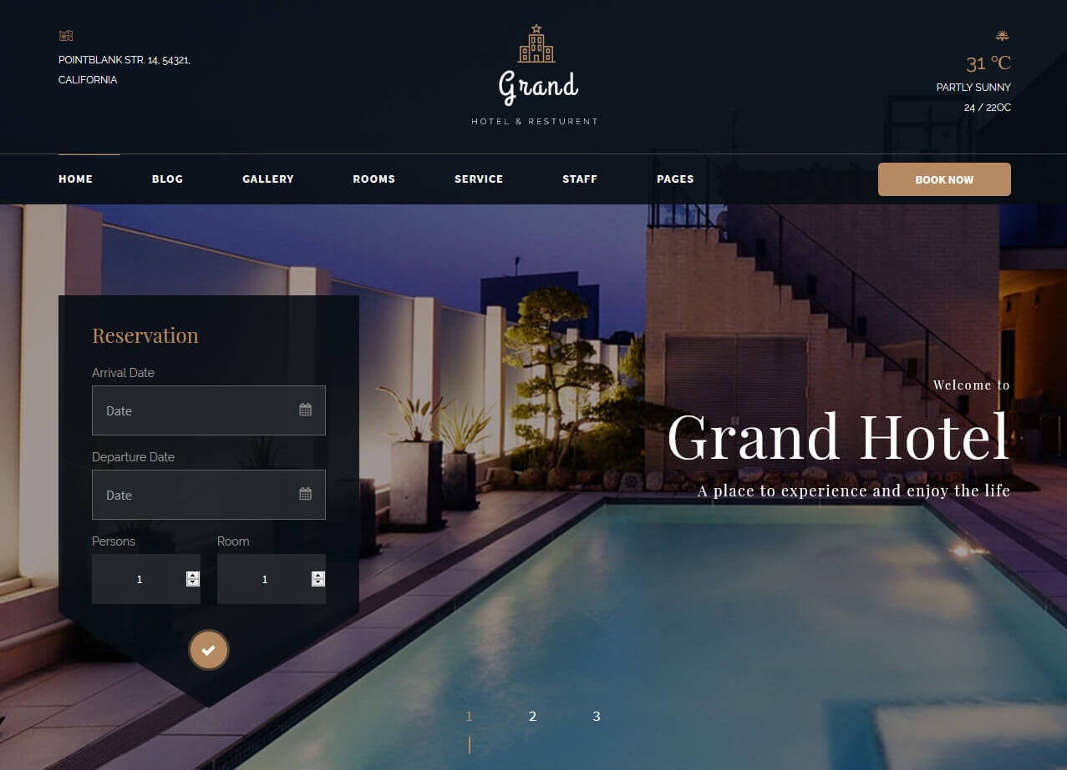
layout/design

Slide 5



Technology used
Language
IDE
Libraries
Visual Studio Code
Tkinter,Pillow,SQLAlchemy
python

Slide 6
hotel management project is a software application that is being developed in Python. The main purpose of the application is to automate and streamline the operations of a hotel.
SUMMARY
“
”
Thank You

Slide 7
THANK YOU
Suryansh Taragi
Taragisuryansh@gmail.com

